Slide 1
REVIEW - 4
TITLE | "Plant Disease Detection Using Deep Learning and IoT Automation"
TEAM ID | B9
GUIDE NAME | Dr. S.K. Chaya Devi Associate Professor
STUDENT NAMES | P. Shivamani R. Lakshya
Roll Numbers | 1602-21-737-113 1602-21-737-091

Slide 2
CONTENTS
Abstract
Introduction
Objective
Literature survey
Existing Methodology
Proposed Methodology
Architecture Diagram
Dataset Description
Implementation
Results
References

Slide 3
ABSTRACT
Agriculture depends on timely data insights
Crop yield predictions improve planning
Soil sensors enable smart irrigation
Machine learning aids crop selection
CNN identifies plant leaf diseases
ThingSpeak and Pi enable live tracking
System supports precision farming goals

Slide 4
INTRODUCTION
Agricultural Impact: Diseases in plants lead to food insecurity and economic loss.
Manual Diagnosis Issues: Error-prone and inefficient, especially for large-scale farming.
Deep Learning Advancement: CNNs (ResNet) can detect disease patterns from leaf images with high accuracy.
Project Goal: Develop a smart AI-based system for detecting plant diseases, predicting crop yield, recommending suitable crops, monitoring soil moisture, and enabling smart irrigation.

Slide 5
OBJECTIVE
To design and develop a hybrid system integrating IoT devices and Deep Learning models
Detect plant diseases using ResNet-based CNN model.
Predict crop yield using machine learning models based on soil and weather data.
Recommend crops based on soil properties.
Enable automated irrigation based on soil moisture levels.
To optimize the system for energy efficiency and scalability

Slide 6
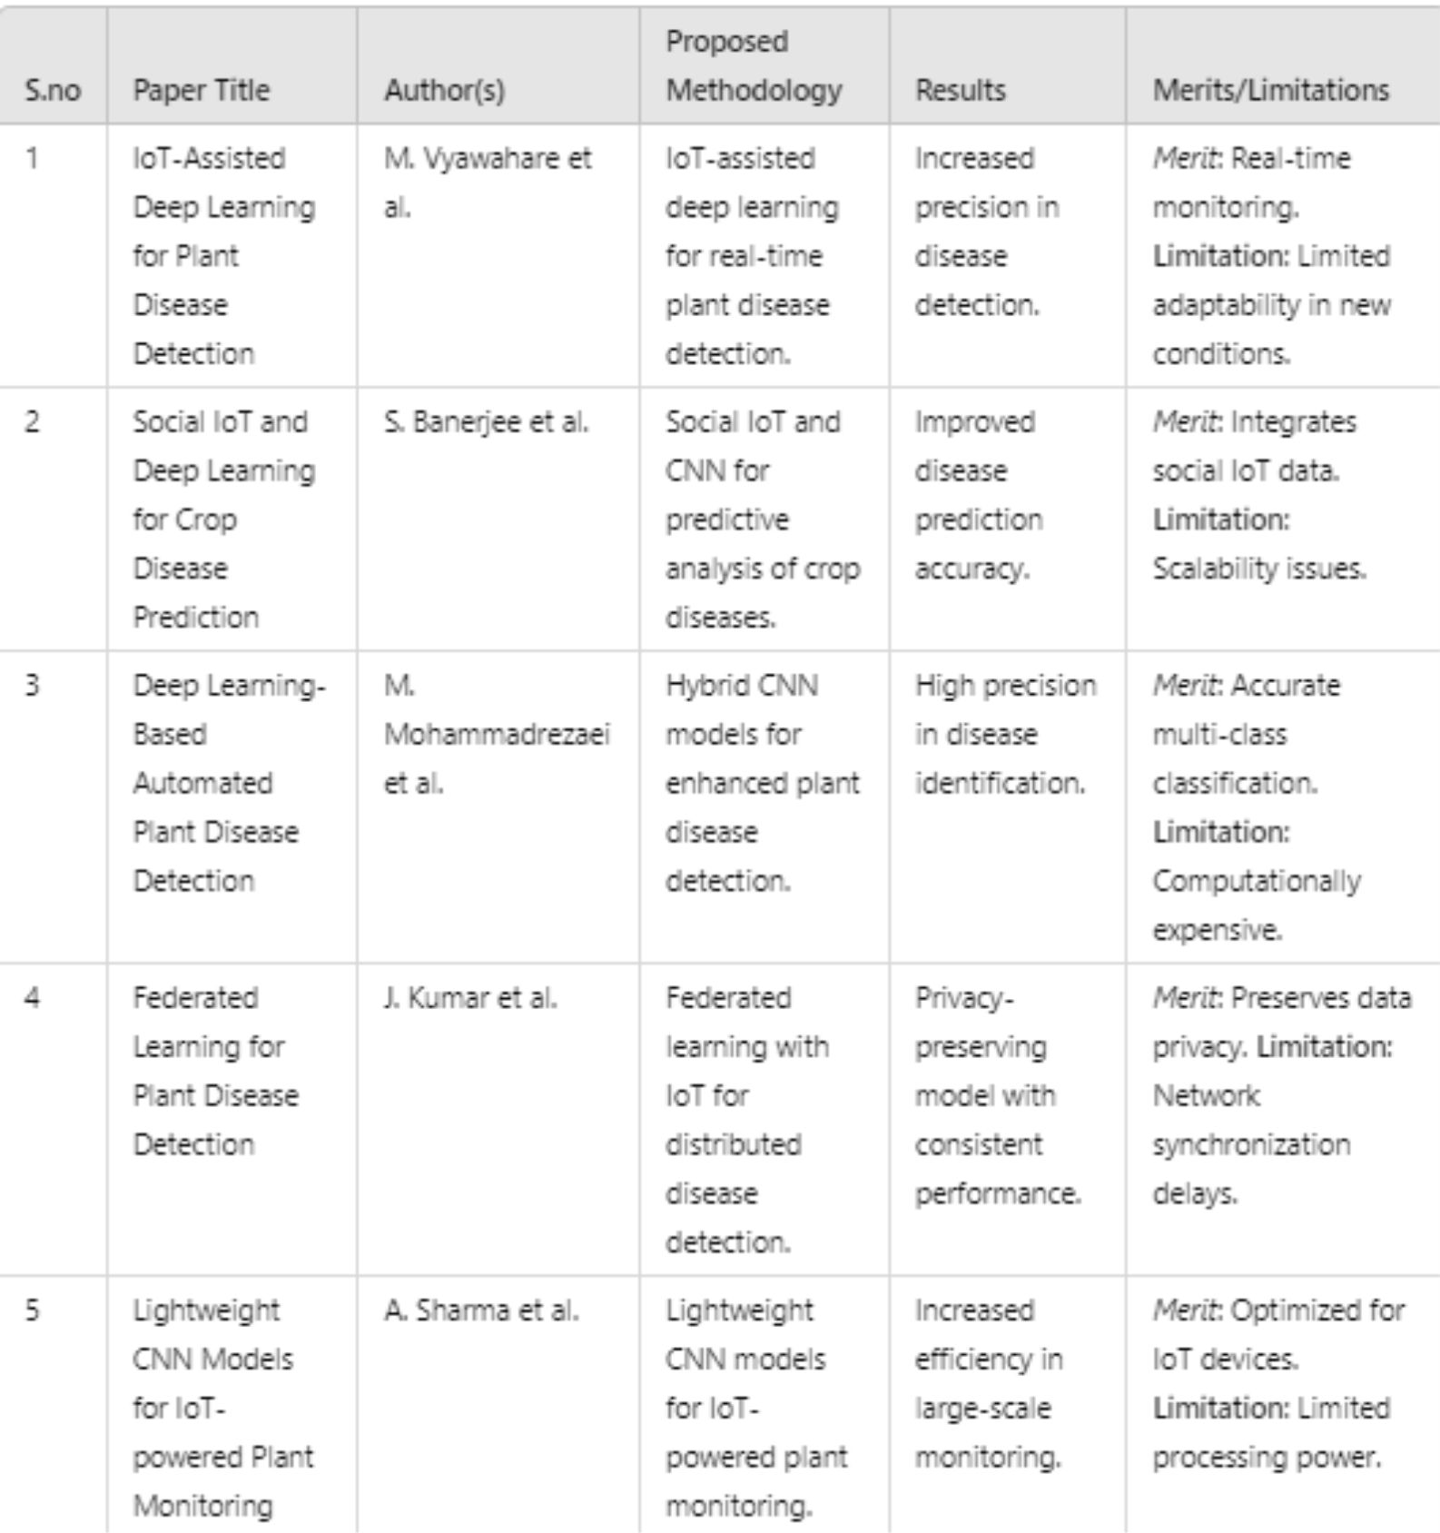
LITERATURE SURVEY

Slide 7
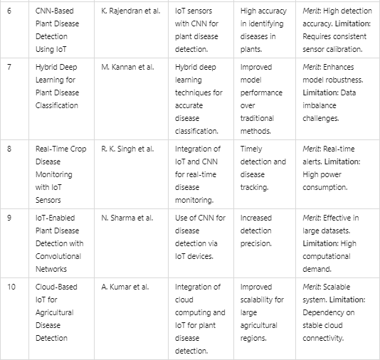
LITERATURE SURVEY

Slide 8
EXISTING METHODOLOGY
The authors discuss multiple DL models—such as AlexNet, GoogleNet, VGGNet, ResNet, and DenseNet—and evaluate their performance for plant disease detection:
DenseNet: Chosen for its efficient gradient flow and feature reuse, minimizing computational costs.
VGGNet and AlexNet: Known for their accuracy in complex classification tasks but require significant storage.

Slide 9
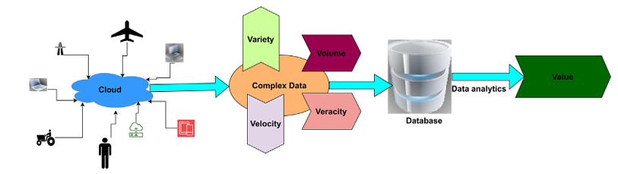
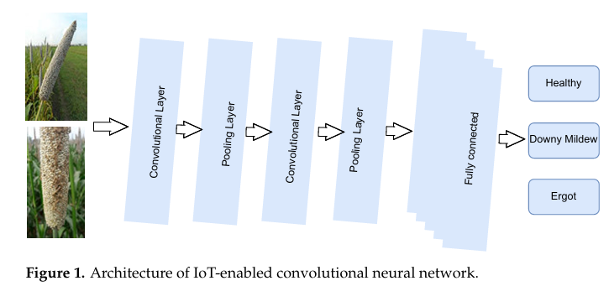
EXISTING METHDOLOGY

Slide 10
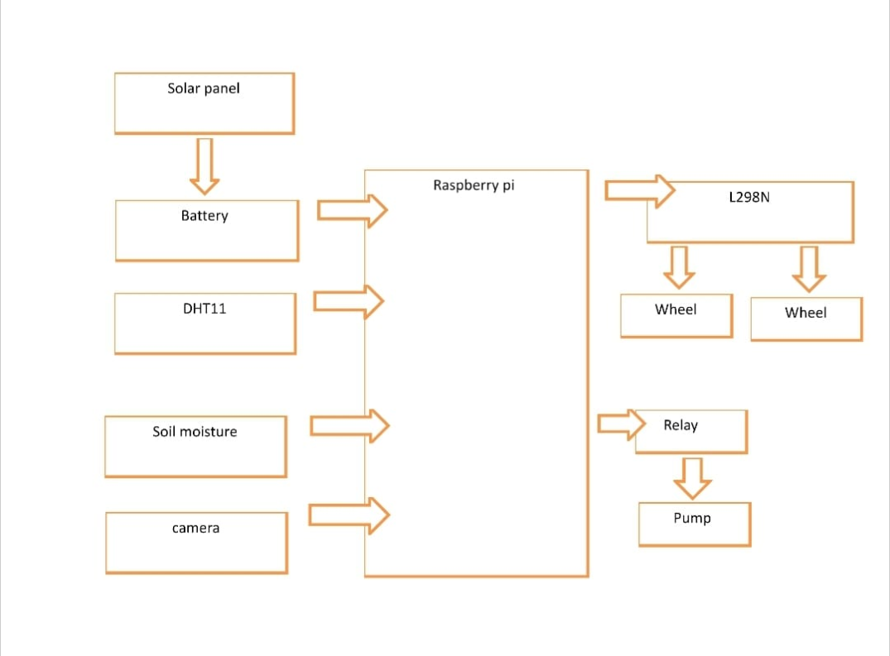
PROPOSED METHODLOGY
IoT Sensors: Deployed in agricultural fields for continuous monitoring of environmental and crop health parameters.
CNN Model: Trained on crop images, it performs feature extraction and disease classification.
Cloud Integration: Data collected by IoT sensors is transmitted to the cloud for processing. A hybrid CNN model is applied to classify diseases and suggest appropriate actions

Slide 11
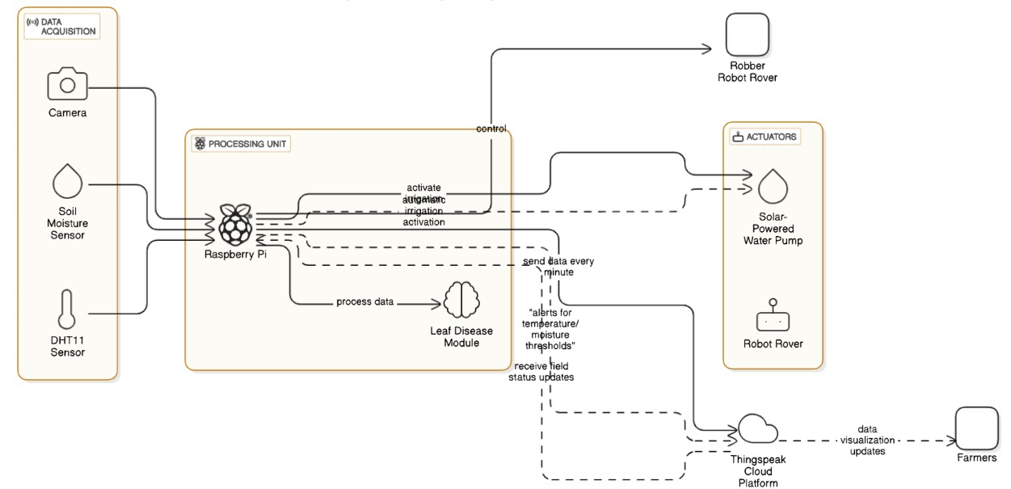
ARCHITECTURE DIAGRAM

Slide 12
DATASET DECRIPTION
Plant Disease Dataset (PlantVillage)Kaggle – 50,000+ labeled leaf images – Covers 38 classes: healthy & diseased crops – Used for training ResNet mode
Crop Recommendation Dataset – Source: Kaggle – Includes N, P, K, temperature, humidity, pH, rainfall – Used for suggesting suitable crops

Slide 13
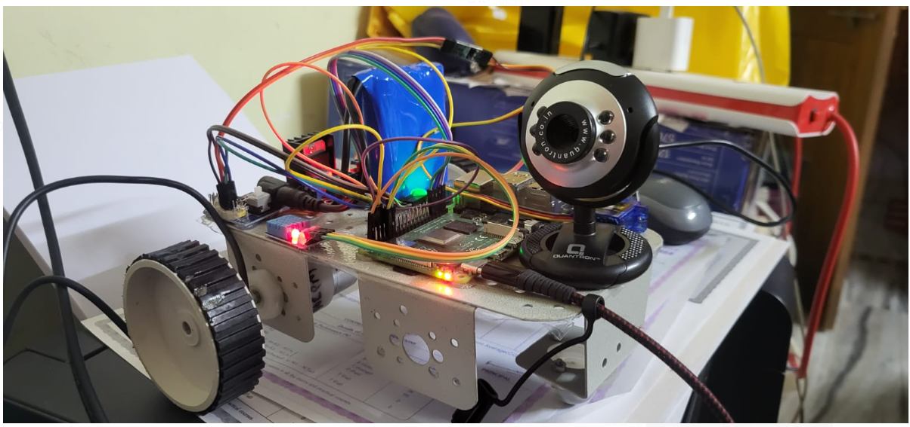
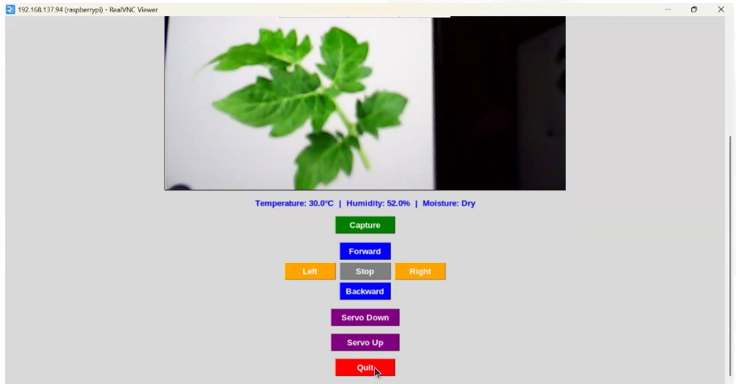
IMPLEMENTATION

Slide 14
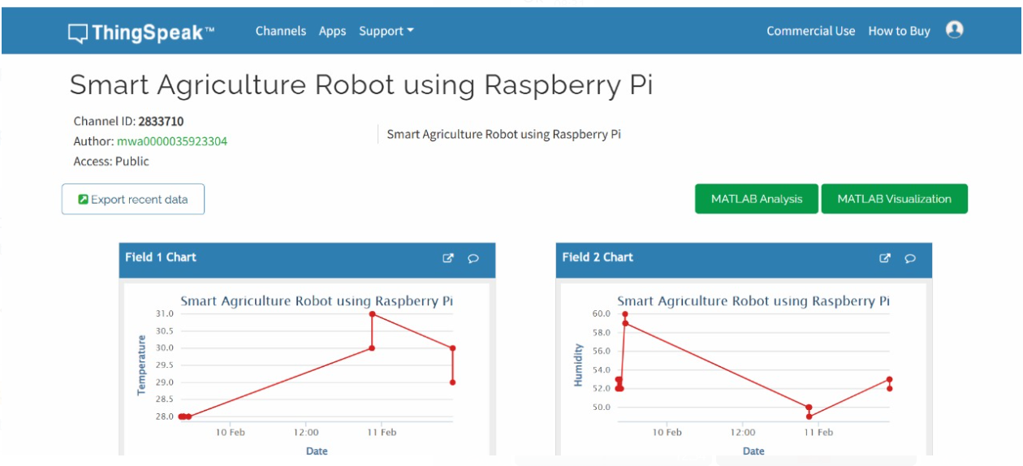
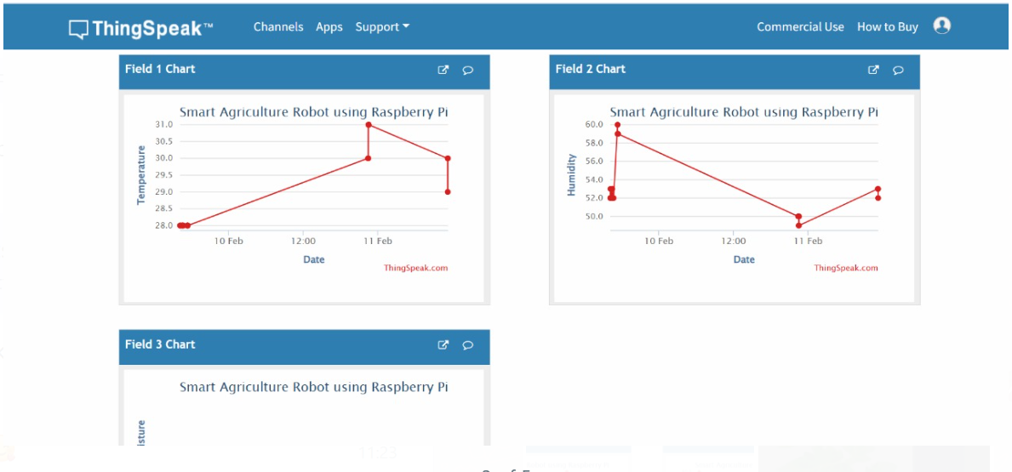
Results

Slide 15
REFERENCES
Vijaypal Singh Dhaka 1, Nidhi Kundu 2, Geeta Rani 1,* , Ester Zumpano 3,4 and Eugenio Vocaturo 3,4 “Role of Internet of Things and Deep Learning Techniques in Plant Disease Detection and Classification: A Focused Review”(2023).
Mohanty, Sharada P., David P. Hughes, and Marcel Salathé. "Using deep learning for image-based plant disease detection." Frontiers in Plant Science 7 (2016): 1419.
Brahimi, Mohamed, Khadidja Boukhalfa, and Abdelouahab Moussaoui. "Deep learning for tomato diseases: Classification and symptoms visualization." Applied Artificial Intelligence 31.4 (2017): 299-315.
Sladojevic, Srdjan, et al. "Deep neural networks based recognition of plant diseases by leaf image classification." Computational Intelligence and Neuroscience 2016 (2016): 1-11.
Ferentinos, Konstantinos P. "Deep learning models for plant disease detection and diagnosis." Computers and Electronics in Agriculture 145 (2018): 311-318.
Too, Eric C., et al. "A comparative study of fine-tuning deep learning models for plant disease identification." Computers and Electronics in Agriculture 161 (2019): 272-279.

